Slide 1


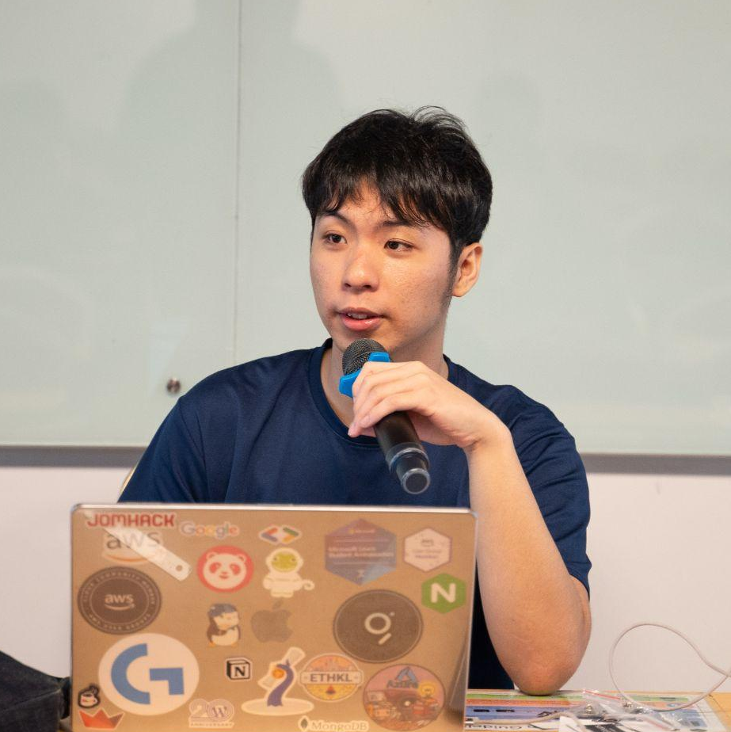
SPEAKER
Lai Kai Yong (Vandyck)
Software Engineer @ Farmz Asia

Slide 2
SPEAKER
Kai Yong Lai (Vandyck)
Software Engineer @ Farmz Asia
Line 1
Line 2
Line 3
Line 4
Line 5
Line 6
Line 7
Software Engineer
+
Community Builder

Slide 3
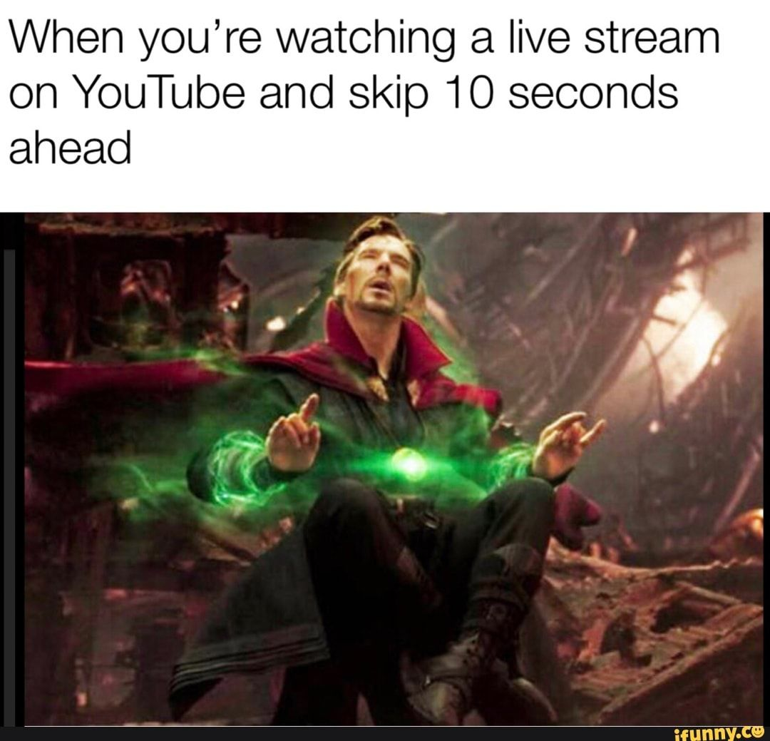

Streaming

Slide 4
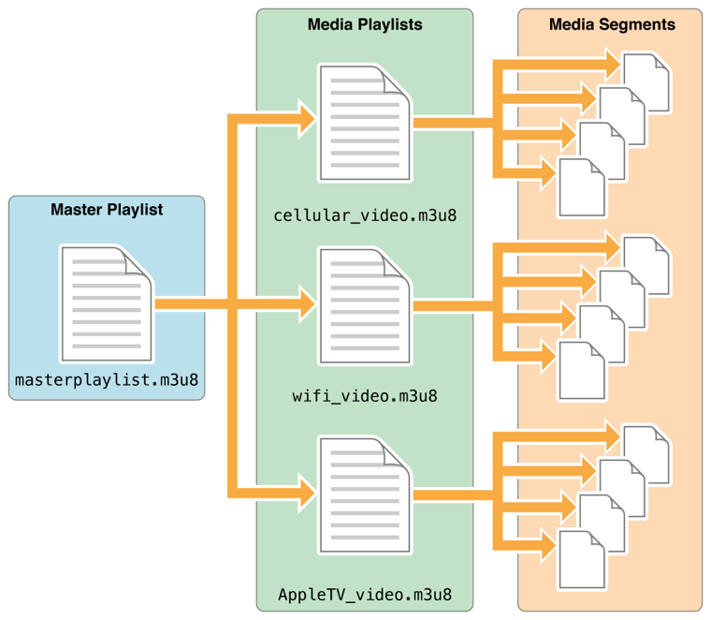
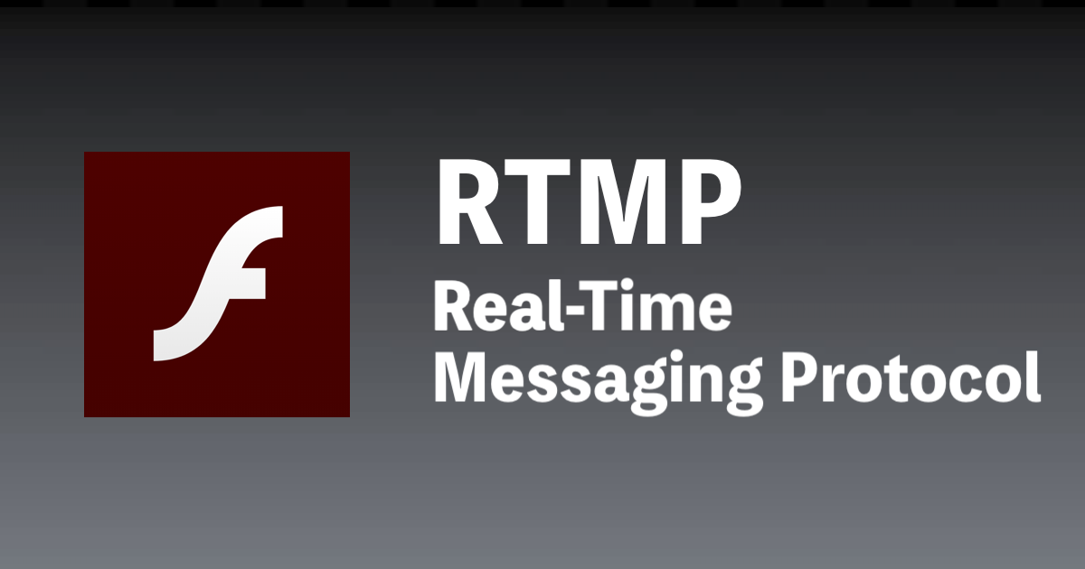
Origin
Now
Flash
RTMP
HLS

Slide 5

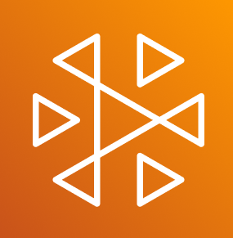
Streaming Service on AWS
Elemental
MediaLive
Interactive Video Service
(IVS)

Slide 6
MediaLive or IVS
MediaLive | IVS
Set Up Required | 1 Click Deployment
30s Latency | ~2s Latency
Unlimited Customization | Minimum Customization
8K Quality Max | 1080p Quality Max
Support Only 1 Resolution | Multiple Resolution

Slide 7
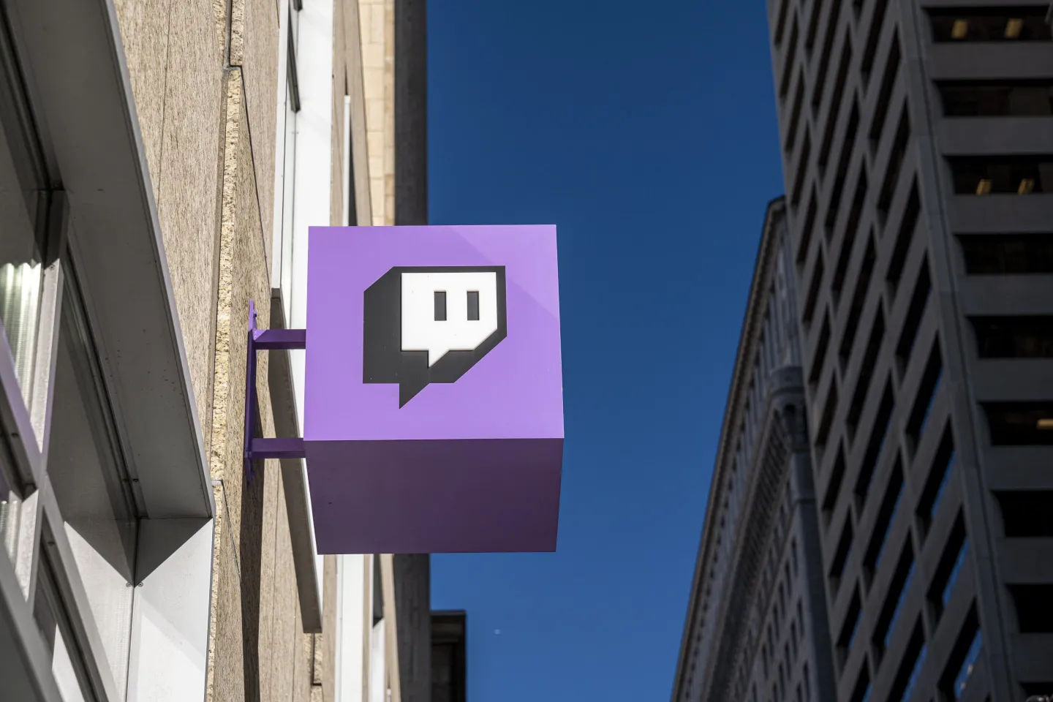

IVS
Cost calculated on
Video Quality
Viewers
Region
Duration Streamed
If building your own
Twitch

Slide 8
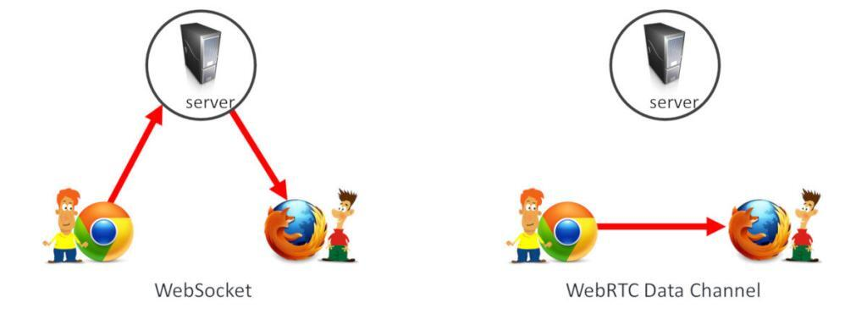
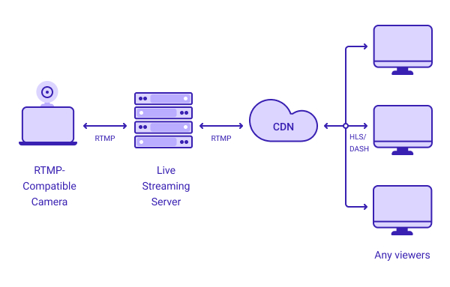
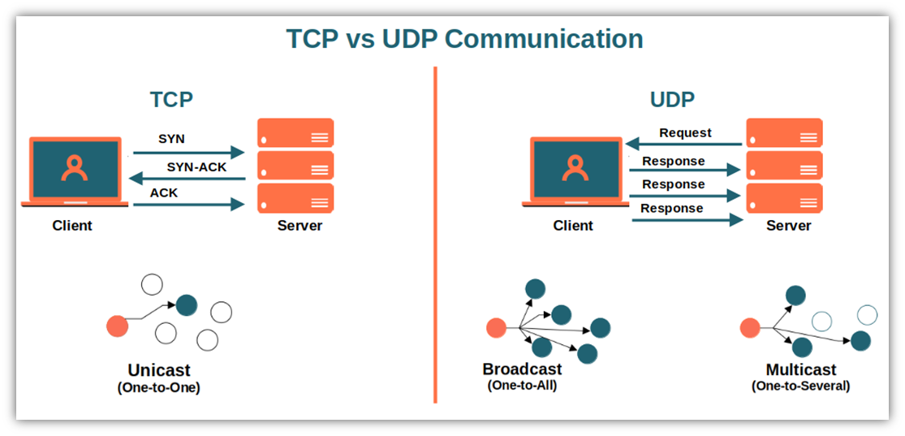
IVS (What is behind it)
RMTP
WebRTC based of UDP

Slide 9
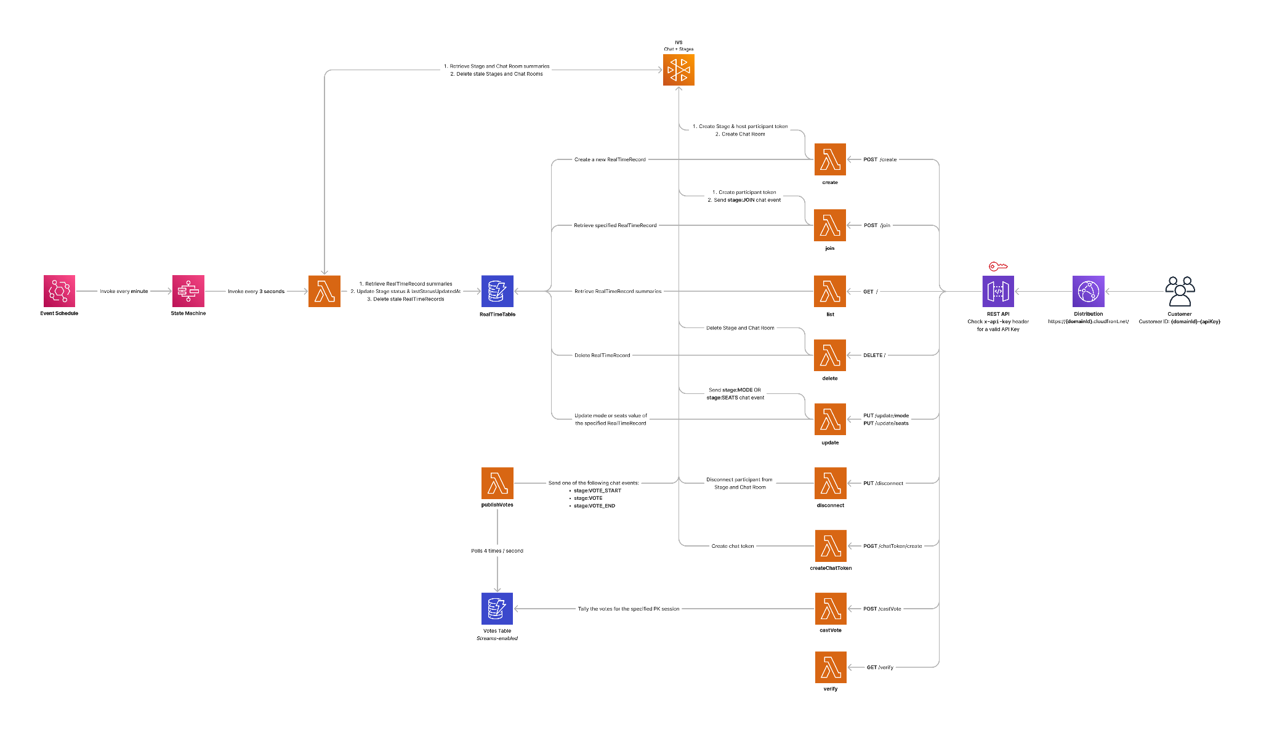
Solution Architecture

Slide 10
DEMO & Explore Examples

Slide 11

Join my Livestream

